Slide 1
Cardiovascular disease in low- and middle-income countries associated with environmental factors
Abstract
There is a growing recognition that the profound environmental changes that have occurred over the past century pose threats to human health. Many of these environmental factors, including air pollution, noise pollution, as well as exposure to metals such as arsenic, cadmium, lead, and other metals, are particularly detrimental to the cardiovascular health of people living in low-to-middle income countries (LMICs). Low-to-middle income countries are likely to be disproportionally burdened by cardiovascular diseases provoked by environmental factors. Moreover, they have the least capacity to address the core drivers and consequences of this phenomenon. This review summarizes the impact of environmental factors such as climate change, air pollution, and metal exposure on the cardiovascular system, and how these specifically affect people living in LMICs. It also outlines how behaviour changes and interventions that reduce environmental pollution would have significant effects on the cardiovascular health of those from LMICs, and globally.

Slide 2
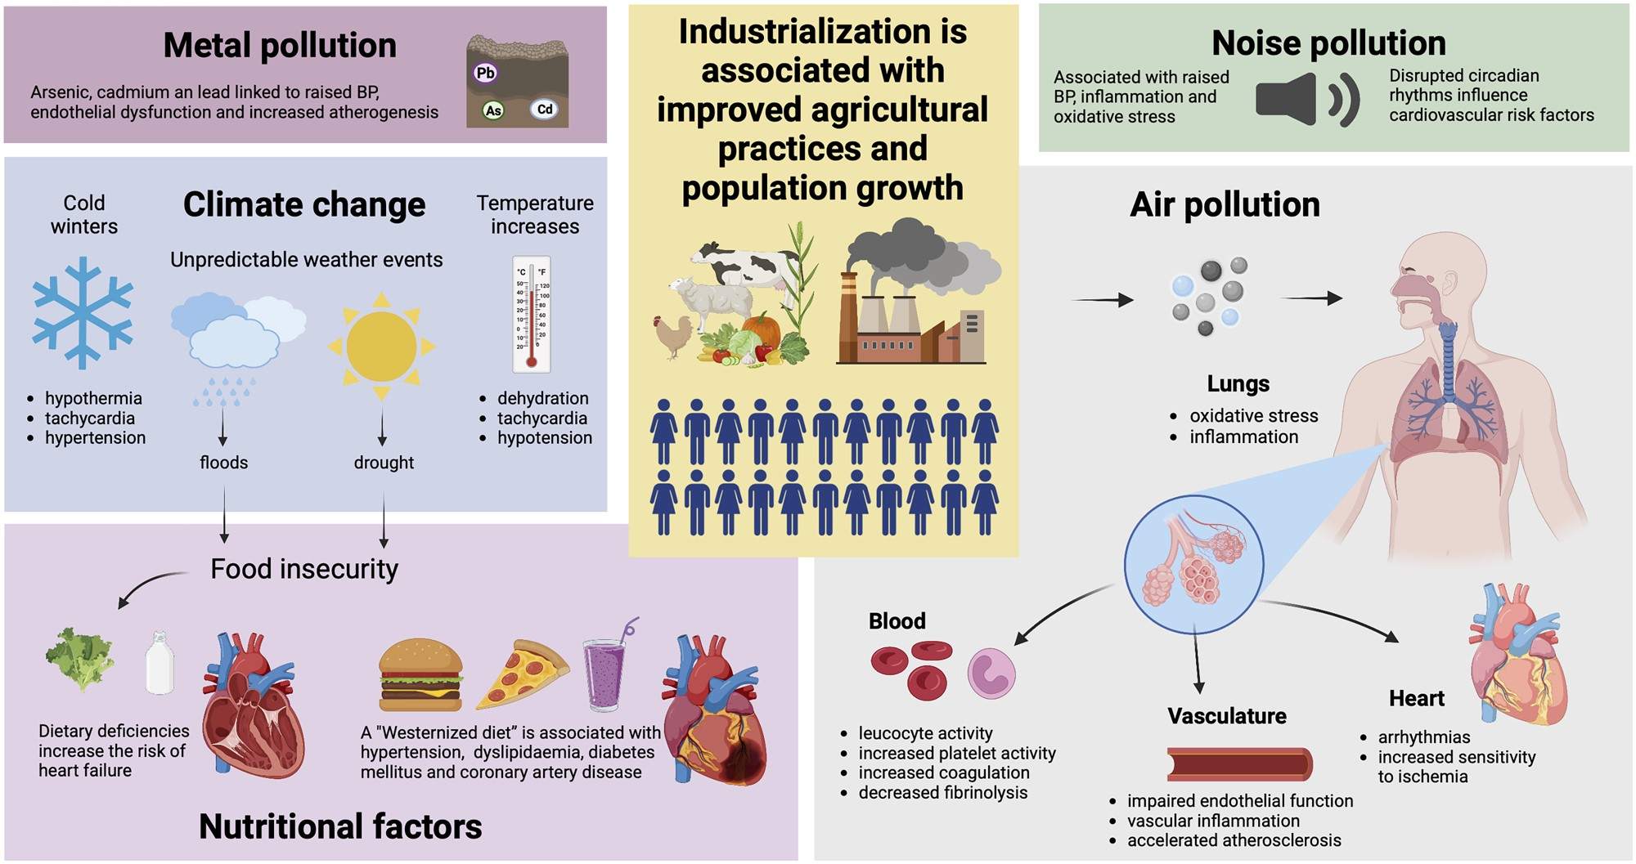
Graphical Abstract
Notes:
Graphical Abstract
Unless provided in the caption above, the following copyright applies to the content of this slide: © The Author(s) 2024. Published by Oxford University Press on behalf of the European Society of Cardiology. All rights reserved. For permissions, please e-mail: journals.permissions@oup.comThis article is published and distributed under the terms of the Oxford University Press, Standard Journals Publication Model (https://academic.oup.com/pages/standard-publication-reuse-rights)

